Slide 1

Efforts by:
111056 Shivam Patil
111055 Ziya Qureshi
111056 Shreerang
Mhatre
111057 Harshvardhan Patil
DTL Term Project
Area : Designs in the farming sector

Slide 2
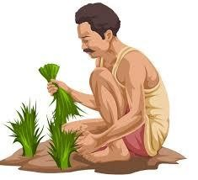
Index
01
Product Pitch
02
Consumer Base
Area: Designs in the farming sector
03
Design Specifications
04
Costing
05
User/Safety guidelines

Slide 3
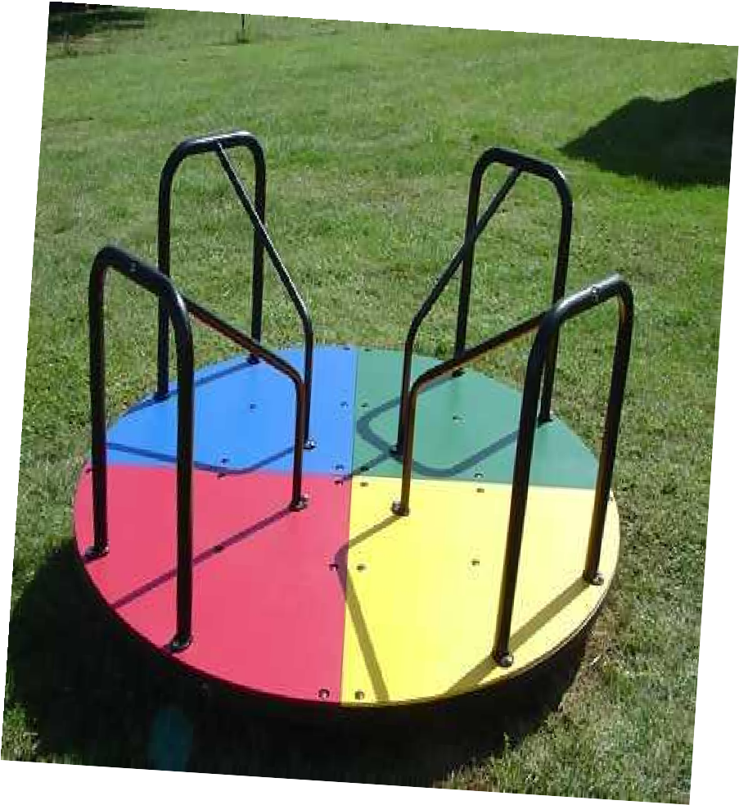

Problem Statement
Lack of water harvesting technologies for fresh irrigational water
Our Product:
Recreational
pumps !

Slide 4
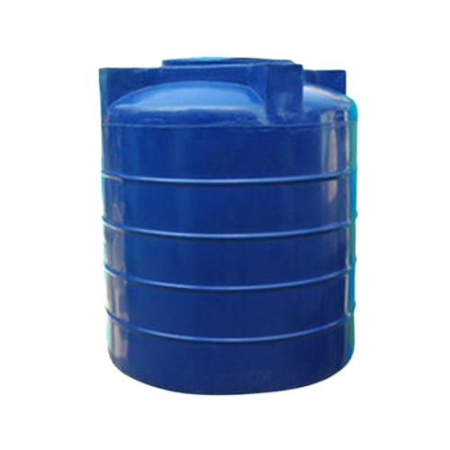


nal Pumps
Pumps that extract
water from the
Recreatio
mechanical energy of
children playing on
them, stored in a tank
for further crop
irrigation

Slide 5

Consumer Base
Primary/Secondary market
Farmers, farmer organizations NGOs, barns/farms, cottage industries, remote areas
Hypothetical Key Business Goals
3 pumps per 5 hectares in the north, selling 500 units per year, expansions
Key Stakeholders
Farmers, labourers, transporters, middlemen, retailers, NGOs/Organizations, local authorities
Business
goals
Future &
potential

Slide 6


Design Specifications
Components
Manufacturing
Materials
Maintenance
Galvanized steel/ iron handles foam core pipes axle hubs
small wheels Cylinders
valves (piston/foot) screws, nuts and bolts
Iron/Steel Handles Wooden Multi Layer disk base Custom Foam Core pipes
Internal Cylinder
Iron, Galvanized steel, foam core, oak wood
Self Sustaining for the most part Check needed for build every 6 to 12 months!

Slide 7
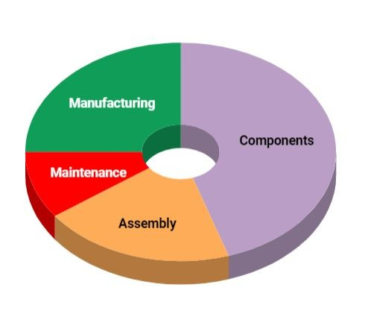
Costing
45%
Components & Costing
25%
Manufacturing
20%
Assembly
10%
Maintenance

Slide 8
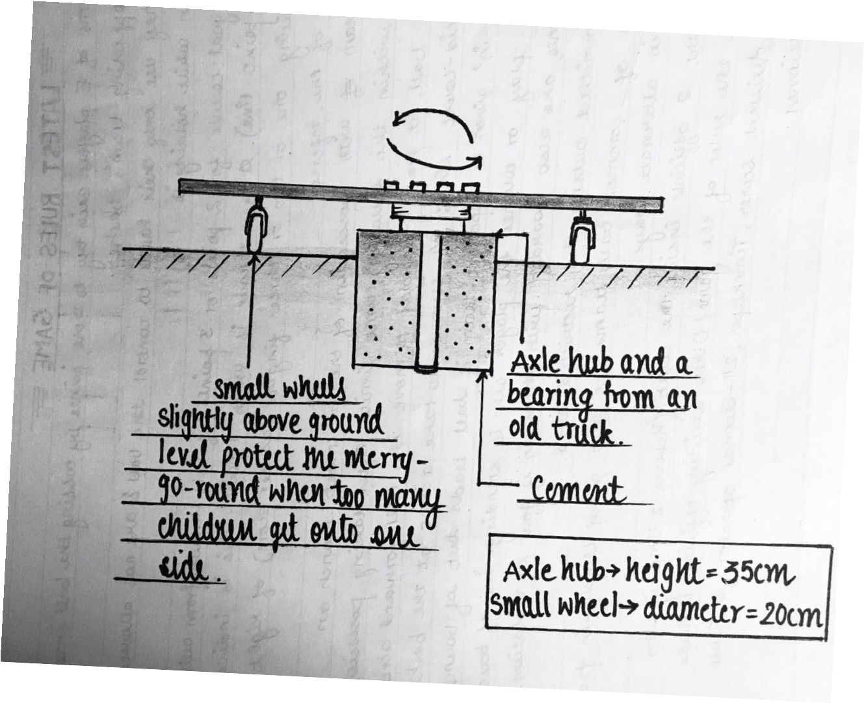
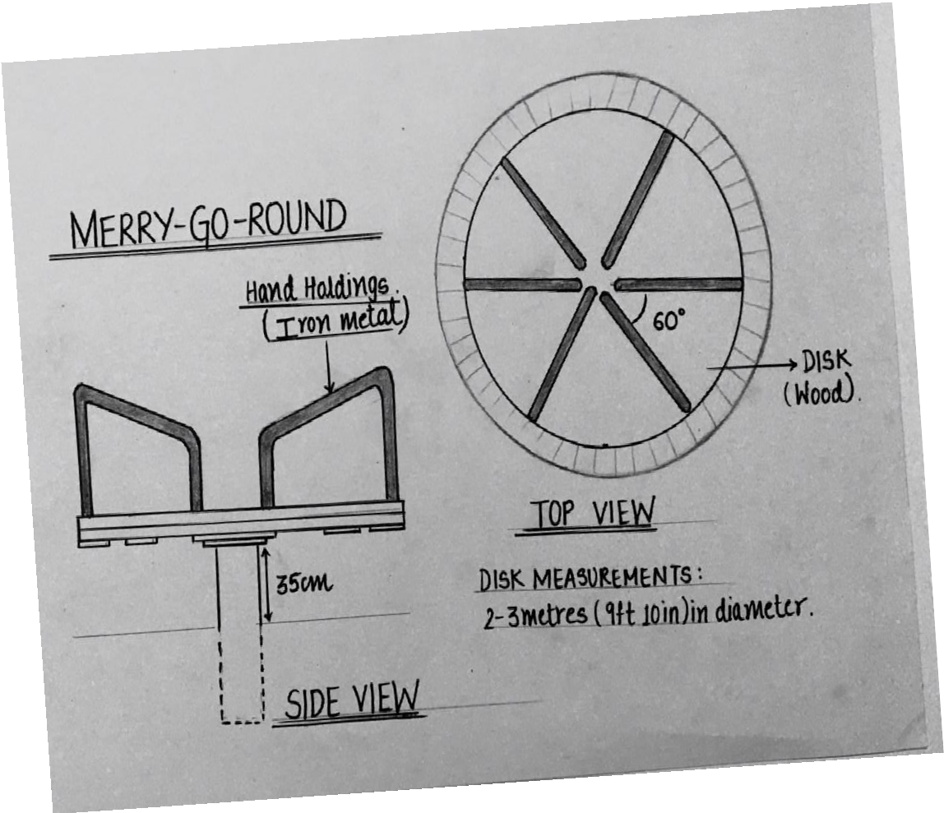
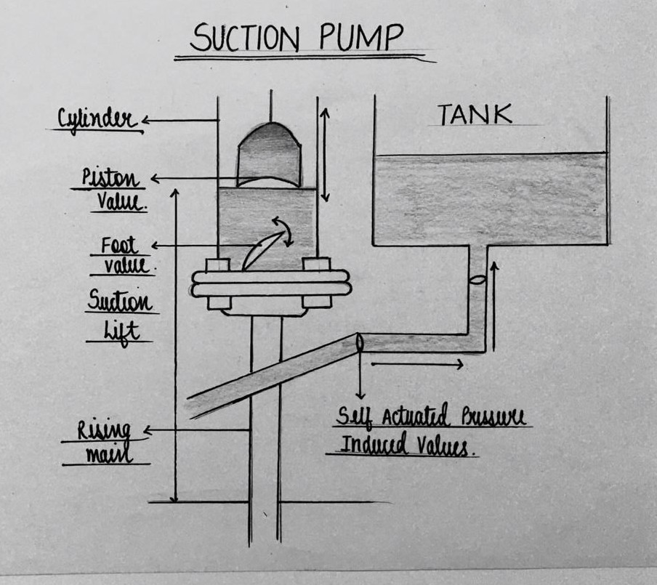
Specific
components
(with detailed internal
specs)
Merry Go Round (side)
Merry Go Round(top)
Suction pump

Slide 9



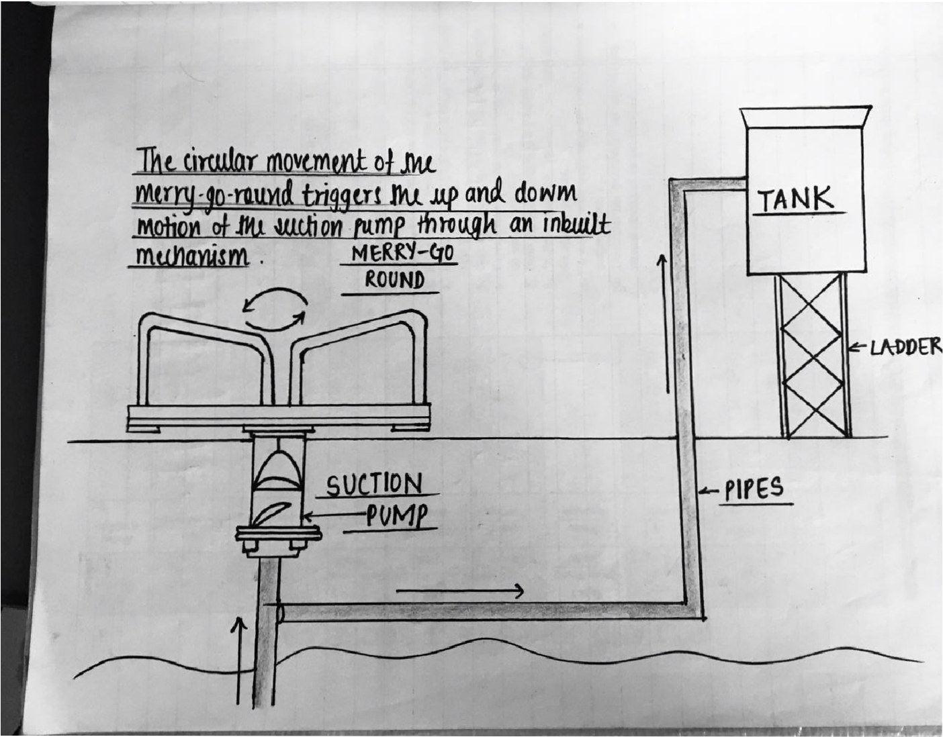








BluePrint of final design

Slide 10


User/Safety Guidelines
User Guidelines
Machine testing before
DOs:
installation,
automatic internal
Usage permitted for 7 to 18 y/os
pumping and water
storage, installed at
Supervision of adults/care while
groundwater level
stepping up needed
DONTs:
Use ladders to
Climbing the ladder on the pump
clean tanks
every 4-8 weeks
Reckless usage of the setup

Slide 11
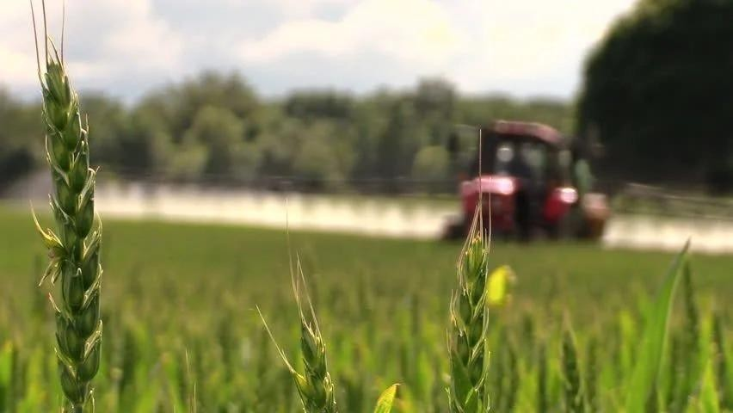
Conclusion
Our product here made by
procedural brainstorming
ends up mitigating the fresh
water issue in rural areas by
using brainstorming to finally
end up with the most efficient
structure for the end product
design.

Slide 12
References
https://spanpumpsindia.com/joy-pump-se e-saw-pump/
https://csrbox.org/India-CSR-projects-pro posal_Span-Pumps-Private-Limited_Sch ool-Drinking-and-Sanitation-Water_179
https://www.letsendorse.com/innovation/i nnovative-see-saw-mechanism-to-pump- groundwater
http://bhoomimagazine.org/2017/04/01/tr aditional-and-innovative-water-conservati on-methods-in-india/
Thank you!
CREDITS: This presentation template was created by Slidesgo, including icons by Flaticon, and infographics & images by Freepik

